Slide 1


Slide 2

Digital Transformation
Challenges & Opportunities
Montalcino, July 14th 2023
2

Slide 3

A QUICK INTRODUCTION OF MYSELF
PRESENTATION
DUCCIO
VITALI
—
CEO of Alkemy
FORMATION
1990 - 1995
Degree in Industrial
Technology Engineering
1998 - 1999
MBA at SDA Bocconi
Professional Experience
1995 - 1998
General Manager
in an Internet Startup
2000 - 2012
Partner at Bain & Co.
(Milan, Dallas and Dubai Offices)
Since 2012
Founder and CEO of Alkemy

Slide 4
Alkemy: the digital transformation leader in italy
4
⁽¹⁾ Revenues 2012-13-14--15-16 are Management estimate and are not audited because of introduction of IFRS in 2017

Slide 5
AGENDA
1– THE DIGITAL TRANSFORMATION CHALLENGE
2– THE 5 RULES OF DIGITAL TRANSFORMATION
3– WRAP-UP, TAKE-AWAYS AND QUESTIONS

Slide 6
THE DIGITAL TRANSFORMATION CHALLENGE

Slide 7
LESS THAN
1 COMPANY OUT OF 20
IS CREATING
SUSTAINABLE VALUE
WITH DIGITAL

Slide 8













THE VALUE CREATED BY DIGITAL HAS BEEN SO FAR CAPTURED BY DIGITAL PLAYERS
THE DIGITAL REVOLUTION
TOP 5 COMPANIES FOR MARKET CAP
3.969 B€
June 29° 2007:
APPLE LAUNCHES IPHONE
100%
100%
DEC 2005
DEC 2009
DEC 2013
DEC 2017
DEC 2019
=
Traditional Players
=
"Digital Players"
8
8
Source: Alkemy analysis on brand’s balance sheet and press releases

Slide 9
COMPANIES CREATE VALUE OUT OF DIGITAL ONLY WHEN DIGITAL BECOMES A REAL ENABLER OF THE WHOLE BUSINESS
THE DIGITAL REVOLUTION
"NO DIGITAL /
POOR DIGITAL"
"SEGREGATED DIGITAL"
"FULL DIGITAL /
INTEGRATED DIGITAL"
DISTRIBUTION
DIGITAL ACCELERATION
VALUE CREATION
9
DIGITAL MATURITY

Slide 10
AN ANALYSIS OF ALKEMY DONE ON THE LISTED COMPANIES, SHOW A LOW DEGREE OF DIGITAL MATURITY, PREVENTING THEM FROM EXTRACTING VALUE OUT OF DIGITAL
THE DIGITAL REVOLUTION
"NO DIGITAL /
POOR DIGITAL"
"SEGREGATED DIGITAL"
"FULL DIGITAL /
INTEGRATED DIGITAL"
DISTRIBUTION
21%
53%
26%
DIGITAL MATURITY
DIGITAL ACCELERATION
VALUE CREATION
10
Source: Alkemy Digital Enabling Index Study

Slide 11
SUCH DEGREE OF DIGITAL MATURITY VARIES SUBSTANTIALLY BY INDUSTRY
THE DIGITAL REVOLUTION
"NO DIGITAL /
POOR DIGITAL"
"SEGREGATED DIGITAL"
"FULL DIGITAL /
INTEGRATED DIGITAL"
DISTRIBUTION
Industrial Goods
Financial Services
TMT
Consumer Goods
Utilities
DIGITAL MATURITY
DIGITAL ACCELERATION
VALUE CREATION
11
Source: Alkemy Digital Enabling Index Study

Slide 12

THE DIGITAL REVOLUTION REQUIRES COMPANIES TO REWIRE THEIR BUSINESS MODEL TO FULLY REAP THE BENEFITS AND COMPETE ON THE MARKET
THE DIGITAL REVOLUTION
THE REASONS TO GO DIGITAL
C
Customer Experience
Digital enables companies to interact directly with their customers and manage their customer experience in an innovative and effective way in all its phases
DIGITAL
TRANSFORMATION
The remarkable volume of data produced on various digital touchpoints and advanced analytics technologies allow companies to extract increasingly relevant insights to optimize business decisions
D
Big Data & Analytics
I
Innovation Governance
The speed and heterogeneity of change have modified companies' scope: they cannot manage innovations by themselves, so new governance models are required
12

Slide 13
DIGITAL TRANSFORMATION IMPLIES A REDEFINITION OF THE BUSINESS MODEL TO BE ABLE TO CAPTURE THE FULL VALUE OFFERED BY DIGITAL
THE DIGITAL REVOLUTION
"NO DIGITAL /
POOR DIGITAL"
"SEGREGATED DIGITAL"
"FULL DIGITAL /
INTEGRATED DIGITAL"
DISTRIBUTION
Digital Transformation
DIGITAL MATURITY
DIGITAL ACCELERATION
VALUE CREATION
13

Slide 14
THE 5 RULES OF DIGITAL TRANSFORMATION

Slide 15

1.ROLE AND VISION

Slide 16

2.STARTING FROM THE CLENTS

Slide 17
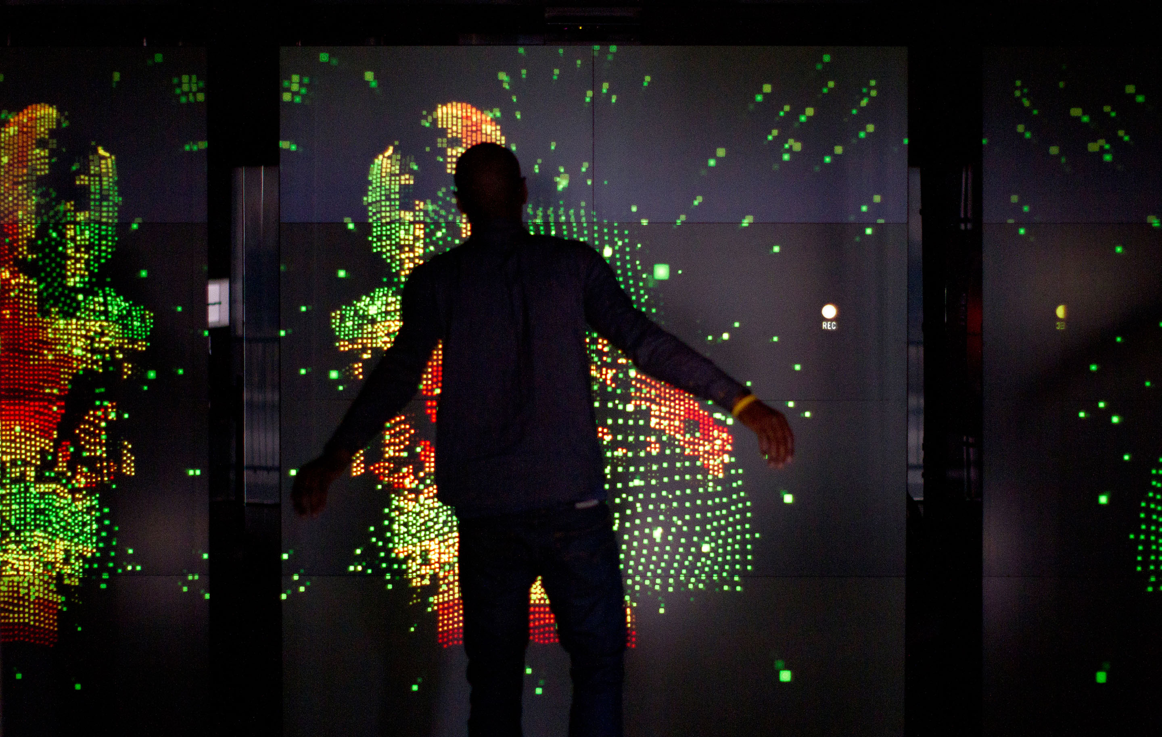
3.EVOLVING COMPETENCIES

Slide 18

4.CHALLENGING THE “STATUS QUO”

Slide 19

5.MEASURE, MEASURE, MEASURE

Slide 20
WRAP-UP, TAKE-AWAYS AND QUESTIONS

Slide 21



DIGITAL AS A TRASFORMATION MINDSET
WHAT’S NEXT
Quantum
computing
metaverse
AI
A virtual-reality space in which users can interact with a computer -generated environment and other users.
The use and development of computer systems that are able to learn and adapt without following explicit instructions, by using algorithms and statistical models to analyse and draw inferences from patterns in data.
A rapidly-emerging technology that harnesses the laws of quantum mechanics to solve problems too complex for classical computers.

Slide 22
The 5 key questions related to digital
To start it up
1—
How are my customers’ needs evolving? How digital can help improve the overall customer experience?
2—
Is it clear within the company what is the role of digital in supporting company’s goals? Is it clear what digital is?
3—
Do we use digital to improve our knowledge of customers? Do we have the right infrastructure to gather, analyze and make available those data?
4—
Are the investments on digital adequate? Which are the expected returns? Do we measure them correctly? Do we have a business plan for digital?
5—
Do we have the right organization in place? Do we have the right competencies? Do we have a plan to fill the gaps?

Slide 23
ANY FURTHER QUESTIONS?
ALKEMY — ENABLING EVOLUTION — VIA S. GREGORIO 34 — 20124 MILANO, ITALY — TEL: +39 02 928941 — INFO@ALKEMY.COM

